Slide 1
Module 2-Network Layer

Slide 2
Routing algorithms: The Optimality Principle, Shortest Path Routing, Flooding, Distance Vector Routing, Link state Routing, Hierarchical Routing.
Congestion Control Algorithms: General Principles of Congestion Control, Congestion Prevention Policies, Congestion Control in Virtual-Circuit Subnets, Congestion Control in Datagram Subnets, Load Shedding, Jitter Control.
Chapter 5: 5.2, 5.3

Slide 3
Routing Algorithms
The main function of NL (Network Layer) is routing packets from the source machine to the destination machine.
There are two processes inside router:
a) One of them handles each packet as it arrives, looking up the outgoing line to use for it in the routing table. This process is forwarding.
b) The other process is responsible for filling in and updating the routing tables. That is where the routing algorithm comes into play. This process is routing.
It should process properties, like correctness, simplicity, robustness, stability, fairness, and optimality.

Slide 4
Different Routing Algorithms
  Optimality principle
  Shortest path algorithm
  Flooding
  Distance vector routing
  Link state routing
  Hierarchical Routing

Slide 5
  Optimality principle
One can make a general statement about optimal routes without regard to network topology or traffic. This statement is known as the optimality principle
Optimality principle: if router J is on optimal path from router I to router K, then optimal path from J to K also falls along same route

Slide 6
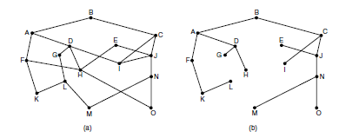
Set of optimal routes from all sources to a given destination form a tree rooted at the destination. Such a tree is called a sink tree
The goal of all routing algorithms is to discover and use the sink trees for all routers.

Slide 7
Shortest Path Routing(Dijkstra’s)
It is really the least-cost path routing, based on dynamic programming for optimisation
The idea is to build a graph of the subnet, with each node of the graph representing a router and each arc of the graph representing a communication line or link.
To choose a route between a given pair of routers, the algorithm just finds the shortest path between them on the graph

Slide 8
1. Start with the local node (router) as the root of the tree. Assign a cost of 0 to this node and make it the first permanent node.
2. Examine each neighbor of the node that was the last permanent node.
3. Assign a cumulative cost to each node and make it tentative
4. Among the list of tentative nodes
  a. Find the node with the smallest cost and make it Permanent
  b. If a node can be reached from more than one route then select the route with the shortest cumulative cost.
5. Repeat steps 2 to 4 until every node becomes permanent

Slide 9
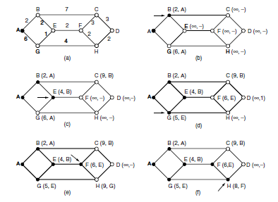

Slide 10
Dijkstra’s Routing algorithm
Initialization
N = {A} // A is a root node.
for all nodes v
if v adjacent to A
then D(v) = c(A,v)
else D(v) = infinity
loop
find w not in N such that D(w) is a minimum.
Add w to N
Update D(v) for all v adjacent to w and not in N:
D(v) = min(D(v) , D(w) + c(w,v))
Until all nodes in N

Slide 12
Flooding
Another algorithm is flooding, in which every incoming packet is sent out on every outgoing line except the one it arrived on.
Flooding obviously generates vast numbers of duplicate packets, in fact, an infinite number unless some measures are taken to damp the process.
One such measure is to have a hop counter contained in the header of each packet, which is decremented at each hop, with the packet being discarded when the counter reaches zero.
Ideally, the hop counter should be initialized to the length of the path from source to destination.
A variation of flooding that is slightly more practical is selective flooding, where the routers do not send every incoming packet out on every line, only on those lines that are going approximately in the right direction.
Each router remembers the identity of those packets it has already sent out. When duplicate copies of the packet arrives back, they are discarded. This is achieved by source router putting a sequence number in the packet.
Flooding is not practical in most applications.

Slide 13
Advantages
1) In military applications, where large numbers of routers are blown, flooding is desirable.
2) In Distributed database applications, it is some times necessary to update all the databases concurrently, in which flooding is useful.
3) It is used as a metric against which other routing algorithms are compared.
4) Flooding chooses the shortest path, because it chooses all possible path in parallel.

Slide 14
Distance Vector Routing
A distance vector routing algorithm operates by having each router maintain a table giving the best known distance to each destination and which link to use to get there.
The distance vector routing algorithm is sometimes called by other names, most commonly the distributed Bellman-Ford routing algorithm,
In distance vector routing, each router maintains a routing table indexed by, and containing one entry for each router in the network. This entry has two parts: the preferred outgoing line to use for that destination and an estimate of the distance to that destination.
The router is assumed to know the distance to each of its neighbors. If the metric is hops, the distance is just one hop. If the metric is queue length, the router examines each queue. If the metric is delay the router can measure it directly with a special ECHO packets.

Slide 15
Fig.(a) shows the subnet and fig.(b) shows the vectors of J for its neighbors.
Let JA delay is 8, JI delay is 10, JH is 12, JK is 6.
The new route to G from J can be calculated as follows: J can get A in 8 m sec. A can get G in 18 m sec(from table). Hence J can get G in (8+18) 26 m sec.
Similarly the delay to G via I,H and K is (31 +10) =41, (6+12)18, (31+6)37 m sec.
The best of these values is 18, so it makes an entry in its routing table that the delay to G is 18 m sec and that route is via H.

Slide 16
Count-to-Infinity problem
The Count-to-Infinity problem is an issue in a network routing method called distance vector routing, where routers share information with each other to find the best path to a destination. Here’s a simpler breakdown:
Good News Spreads Quickly: When a new, shorter path to a destination is available, routers quickly update their routes. For example, if one router learns there is now a faster way to reach a certain location, it immediately starts using that path. This information spreads fast.
Bad News Travels Slowly: However, when a route goes down (for example, if a router or connection fails), the "bad news" about this problem spreads very slowly. This can cause delays and confusion in the network.

Slide 17
Imagine a network of five routers in a line, named A, B, C, D, and E. The routers know the shortest way to reach each other. But suddenly, A goes down (stops working):
B notices that A is down, but C still thinks it can reach A through B. So C tells B it has a path to A.
B doesn’t realize C’s path actually goes through itself, so B believes it can still reach A through C, even though that’s incorrect.
Over time, each router keeps increasing the "distance" to A, but they still believe A is reachable, which isn't true.
This process continues, with the routers counting up to a high number (counting to "infinity") before they finally realize A is unreachable. This happens because each router only knows what its neighbors tell it, without knowing if it’s part of a looped path.

Slide 18
Why It’s Hard to Fix?
Attempts to solve this problem, like split horizon and poisoned reverse, help reduce it by stopping routers from sharing paths back to where they came from. However, these methods aren’t perfect and don’t solve the problem completely in all cases.
In short, the Count-to-Infinity problem shows that when a route goes down, distance vector routing can be slow to recognize it, creating delays and possible routing loops.

Slide 19
Link State Routing
The primary problem is that the algorithm often took too long time to converge after the network topology changed.
The idea behind link state routing is:
1. Discover its neighbors and learn their network addresses.
2. Set the distance or cost metric to each of its neighbors.
3. Construct a packet telling all it has just learned.
4. Send this packet to and receive packets from all other routers.
5. Compute the shortest path to every other router.
Then Dijkstra’s algorithm can be run at each router to find the shortest path to every other router.

Slide 20
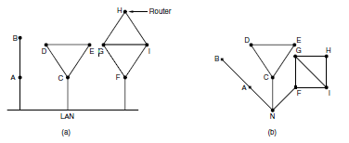
Learning about the Neighbors
When a router is booted, its first task is to learn who its neighbors are.
It accomplishes this goal by sending a special HELLO packet on each point-to-point line. The router on the other end is expected to send back a reply giving its name.

Slide 21
Setting Link Costs
The link state routing algorithm requires each link to have a distance or cost metric for finding shortest paths.
The cost to reach neighbors can be set automatically, or configured by the network operator.
A common choice is to make the cost inversely proportional to the bandwidth of the link.
If the network is geographically spread out, the delay of the links may be factored into the cost so that paths over shorter links are better choices.

Slide 22
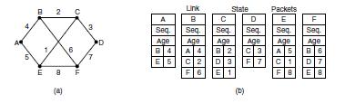
Building Link State Packets
Once the information needed for the exchange has been collected, the next step is for each router to build a packet containing all the data.
The packet starts with the identity of the sender, followed by a sequence number and age and a list of neighbors. The cost to each neighbor is also given.

Slide 23
Distributing the Link State Packets
The fundamental idea is to use flooding to distribute the link state packets to all routers.
To keep the flood in check, each packet contains a sequence number that is incremented for each new packet sent.
Routers keep track of all the (source router, sequence) pairs they see.
When a new link state packet comes in, it is checked against the list of packets already seen.
  If it is new, it is forwarded on all lines except the one it arrived on.
  If it is a duplicate, it is discarded.
  If a packet with a sequence number lower than the highest one seen so far ever arrives, it is rejected as the router has more recent data.

Slide 24
Include the age of each packet after the sequence number and decrement it once per second.
When the age hits zero, the information from that router is discarded.
The Age field is also decremented by each router during the initial flooding process, to make sure no packet can get lost and live for an indefinite period of time.

Slide 25
Computing the New Routes
Once a router has accumulated a full set of link state packets, it can construct the entire network graph because every link is represented.
Every link is, represented twice, once for each direction.
Dijkstra’s algorithm can be run locally to construct the shortest paths to all possible destinations.
OSPF (Open Shortest Path First) is the other main link state protocol.

Slide 26
Hierarchical Routing
At a certain point, the network may grow to the point where it is no longer feasible for every router to have an entry for every other router, so the routing will have to be done hierarchically, as it is in the telephone network.
When hierarchical routing is used, the routers are divided into what we will call regions.
Each router knows all the details about how to route packets to destinations within its own region but knows nothing about the internal structure of other regions.
For huge networks, a two level hierarchy may be insufficient; it may be necessary to group the regions into clusters, the clusters into zones, the zones into groups, and so on,

Slide 27
Ex. Consider a 720 routers subnet.
Without hierarchy each router required 720 entries. Total entries will be 720 x 720, with hierarchy, if the subnet is portioned into 24 regions and 30 routers/region, then each router needs 30+23 = 53 entries only.

Slide 28
CONGESTION CONTROL ALGORITHMS-What is Congestion?
Too many packets present in (a part of) the network causes packet delay and loss that degrades performance. This situation is called congestion.
The network and transport layers share the responsibility for handling congestion. Since congestion occurs within the network, it is the network layer that directly experiences it and must ultimately determine what to do with the excess packets.
However, the most effective way to control congestion is to reduce the load that the transport layer is placing on the network.

Slide 29
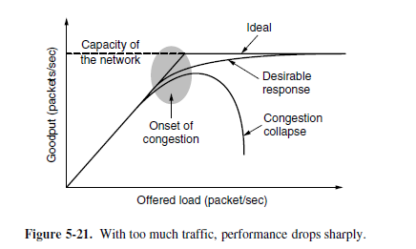
When the number of packets hosts send into the network is well within its carrying capacity, the number delivered is proportional to the number sent.
If twice as many are sent, twice as many are delivered. However, as the offered load approaches the carrying capacity, bursts of traffic occasionally fill up the buffers inside routers and some packets are lost. These lost packets consume some of the capacity, so the number of delivered packets falls below the ideal curve. The network is now congested.

Slide 30
What factors will lead to congestion?
1. Three or four input lines and only one output line, queue will build up.
  If there is insufficient memory to hold all of them, packets will lost.
  Adding infinite memory congestion gets worse, because by the time packets get into the front of the queue, the time out and duplicates have been sent.
2. Slow processors (routers) can cause congestion.
  A slow processor perform tasks very slow, queues will build up.
3. Low band-width lines also cause congestion
  Upgrading lines but not changing the processor and vice-versa shifts the bottleneck.

Slide 31
In flow control, rate of traffic received from a sender can be controlled by a receiver.
Prevents buffer overflow: by regulating the rate at which data is sent from the sender to the receiver.
Helps in handling different data rates: by regulating the flow of data to match the capacity of the receiving device.
Efficient use of network resources: by avoiding packet loss and reducing the need for retransmissions.

Slide 32
On the other hand, In congestion control, rate of traffic from sender to the network is controlled.
Prevents network congestion: by regulating the rate at which data is sent from the sender to the receiver.
Efficient use of network resources: by reducing the number of lost packets and retransmissions.
Fair allocation of network resources: by regulating the rate of data flow for all sources.

Slide 33
General principle of congestion control
Open loop Congestion Control
Open loop congestion control policies are applied to prevent congestion before it happens. The congestion control is handled either by the source or the destination.
Closed Loop Congestion Control
Closed loop congestion control techniques are used to treat or alleviate congestion after it happens.

Slide 34
Congestion Prevention Policies open loop congestion control
Retransmission Policy :
It is the policy in which retransmission of the packets are taken care of.
If the sender feels that a sent packet is lost or corrupted, the packet needs to be retransmitted. This transmission may increase the congestion in the network.
Retransmission timers must be designed to prevent congestion and also able to optimize efficiency.

Slide 35
2. Window Policy :
The type of window at the sender’s side may also affect the congestion.
Several packets in the Go-back-N window are re-sent, although some packets may be received successfully at the receiver side. This duplication may increase the congestion in the network and make it worse.
Therefore, Selective repeat window should be adopted as it sends the specific packet that may have been lost
3.Discarding Policy :
A good discarding policy adopted by the routers is that the routers may prevent congestion and at the same time partially discard the corrupted or less sensitive packages and also be able to maintain the quality of a message.

Slide 36
4. Acknowledgment Policy :
The receiver should send acknowledgement for N packets rather than sending acknowledgement for a single packet.
The receiver should send an acknowledgment only if it has to send a packet or a timer expires.
5. Admission Policy :
Switches should first check the resource requirement of a network flow before transmitting it further.
If there is a chance of a congestion or there is a congestion in the network, router should deny establishing a virtual network connection to prevent further congestion.

Slide 37
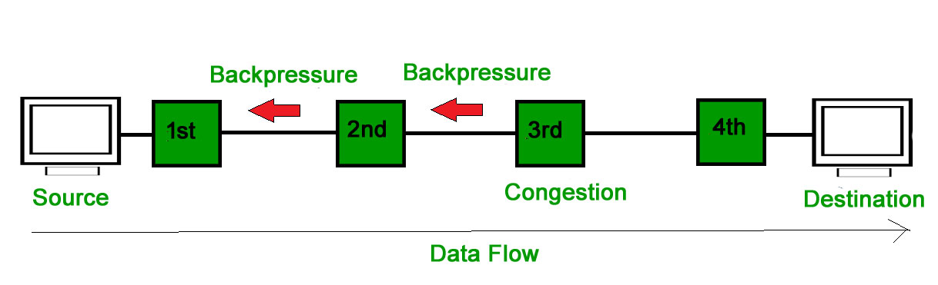
Congestion Prevention Policies
Closed loop congestion control
Backpressure :
Backpressure is a technique in which a congested node stops receiving packets from upstream node.
This may cause the upstream node or nodes to become congested and reject receiving data from above nodes.
Backpressure is a node-to-node congestion control technique that propagate in the opposite direction of data flow.

Slide 38
2. Implicit Signaling :
In implicit signaling, there is no communication between the congested nodes and the source. The source guesses that there is congestion in a network.
  Ex: when sender sends several packets and there is no acknowledgment for a while, one assumption is that there is a congestion
3. Explicit Signaling :
In explicit signaling, if a node experiences congestion it can explicitly sends a packet to the source or destination to inform about congestion.
  Forward Signaling :a signal is sent in the direction of the congestion. The destination is warned about congestion. The receiver in this case adopt policies to prevent further congestion.
  Backward Signaling : a signal is sent in the opposite direction of the congestion. The source is warned about congestion and it needs to slow down.

Slide 39
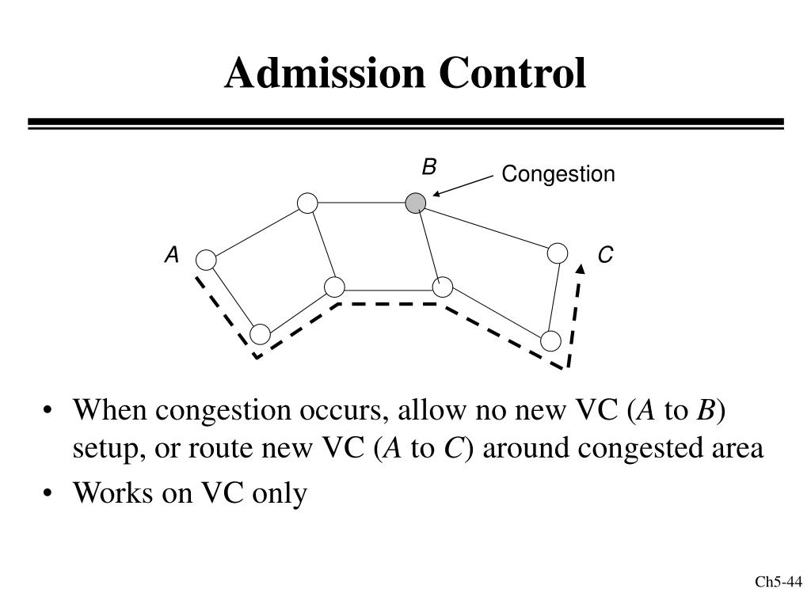
Congestion control in virtual circuit subnet
Admission control:
This technique is used to track the congestion control after it occurred.
Once the congestion occurs in network do not set up any more virtual connection until the congestion is removed.
Alternate approach:
You can add a new connection to the node other than congestion node.

Slide 40
Congestion Control in Datagram Subnets
1.Warning bit
A special bit in the packet header is set by the router to warn the source when congestion is detected.
The bit is copied and piggy-backed on the ACK and sent to the sender.
The sender monitors the number of ACK packets it receives with the warning bit set and adjusts its transmission rate accordingly.

Slide 41
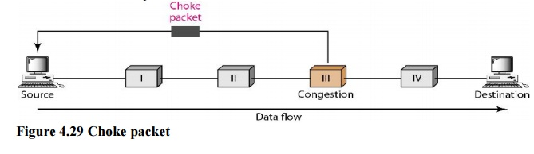
2.Choke packet
A choke packet is a packet sent by a node to the source to inform about congestion.
A more direct way of telling the source to slow down.
A choke packet is a control packet generated at a congested node and transmitted to restrict traffic flow.
The source, on receiving the choke packet must reduce its transmission rate by a certain percentage.
An example of a choke packet is the ICMP Source Quench Packet.

Slide 42
Hop-by-Hop Choke Packets
Over long distances or at high speeds choke packets are not very effective.
A more efficient method is to send to choke packets hop-by-hop.
This requires each hop to reduce its transmission even before the choke packet arrive at the source

Slide 43
3.Hop-by-Hop Choke Packets

Slide 44
Load Shedding
Load shedding is defined as an approach of discarding the packets when the buffer is full .
The selection of packets to discard is an important task. Many times packets with less importance and old packets are discarded.
To implement an intelligent discard policy, applications must mark their packets to indicate to the network how important they are. Then, when packets have to be discarded, routers can first drop packets from the least important class, then the next most important class, and so on.

Slide 45
Random Early detection
Randomly early detection is an approach in which packets are discarded before the buffer space becomes full.
When the buffer is empty set queue size.
Therefore the situation of congestion is controlled earlier. In this approach, the router initially maintains a specific queue length for the outgoing lines.
When this average set line is exceeded it warns for congestion and discards the packets.

Slide 46
Jitter Control
Jitter is an inconsistent delay in the data packets.
Due to network congestion, poor hardware, or lack of packet prioritization, the steady stream of data packets gets disrupted, and the interval between the packets gets uneven, the result is jitter.
The jitter can be bounded by computing the expected transit time for each hop along the path.
  When a packet arrives at router, the router will check to see whether the packet is ahead or behind.
  If the packet is early router will kept is hold.
  If it is late it will send as soon as possible.

Slide 47
The algorithm for determining which of several packets competing for an output line should go next can always choose the packet furthest behind in its schedule. In this way, packets that are ahead of schedule get slowed down and packets that are behind schedule get speeded up, in both cases reducing the amount of jitter.
In some applications, such as video on demand, jitter can be eliminated by buffering at the receiver and then fetching data for display from the buffer instead of from the network in real time.
However, for other applications, especially those that require real-time interaction between people such as Internet telephony and video conferencing, the delay inherent in buffering is not acceptable.
(a) High jitter. (b) Low jitter.

